Slide 1
CPE 10 FUNDAMENTALS OF MIXED SIGNALS AND SENSORS
BSCPE III GE – MW 7:30 – 9:00 BSCPE III GF – TTH 7:30 – 9:00
ENGR. JOEL ANTHONY L. SEVILLA
SEPTEMBER 2023

Slide 2
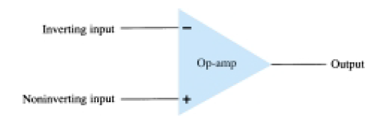
Basic Op-amp
The plus (+) input produces an output that is in phase with the signal applied.
The minus (-) input results in an opposite polarity output.

Slide 3
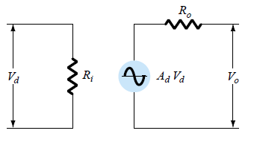
Op-amp ac equivalent circuit
The input signal applied
between input terminals
sees an input impedance,
Ri, typically very high.
The output voltage is shown to be the
amplifier gain times the input signal taken
through an output impedance, Ro, which is
typically very low.

Slide 4
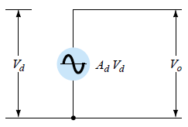
Op-amp ideal circuit
An ideal op-amp circuit, would have infinite input impedance, zero output impedance, and an infinite voltage gain.

Slide 5
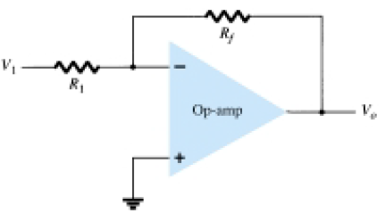
Basic circuit connection using an Op-amp
The circuit shown is a
constant-gain multiplier.
An input signal, V1, is
applied through resistor
R1 to the minus input. The
output is then connected
back to the same minus input through resistor Rf. The
plus input is connected to ground. Since the signal
V1 is essentially applied to the minus input, the
resulting output is opposite in phase to the input signal.

Slide 6
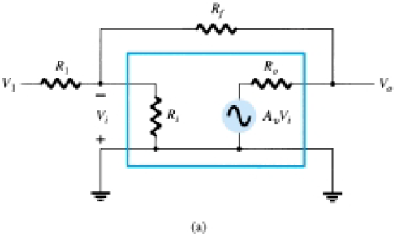
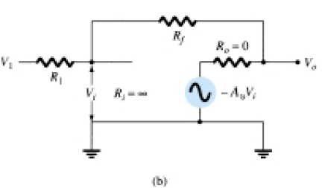
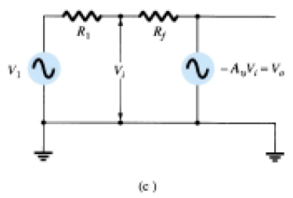
Operation of op-amp as constant-gain multiplier:
op-amp ac equivalent circuit;
(b) ideal op-amp equivalent circuit;
(c) redrawn equivalent
circuit

Slide 7
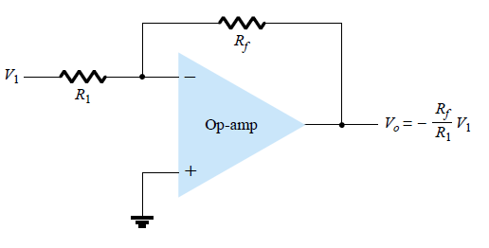

Practical Op-amp circuits
Inverting Amplifier
It is the most widely
used constant-gain amplifier circuit. The output is obtained by multiplying the input by a fixed or constant gain, set by the input resistor (R1) and feedback resistor (Rf). The output is also being inverted from the input.

Slide 8
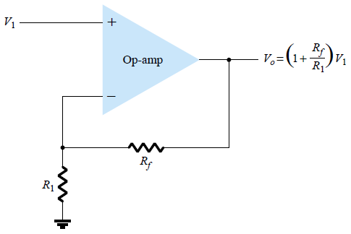

Practical Op-amp circuits
Noninverting Amplifier
The inverting amplifier
connection is more widely
used because it has better frequency stability.

Slide 9
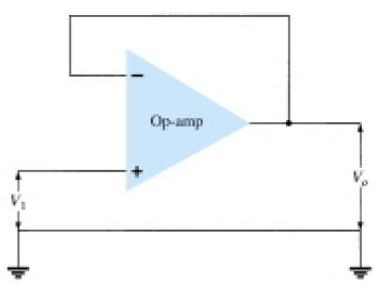
Practical Op-amp circuits
Unity Follower
Vo = Vi
The unity-follower circuit
provides a gain of unity (1)
with no polarity or phase reversal. The output is the
same polarity and magnitude as the input. The circuit
operates like an emitter- or source-follower circuit
except that the gain is exactly unity.

Slide 10
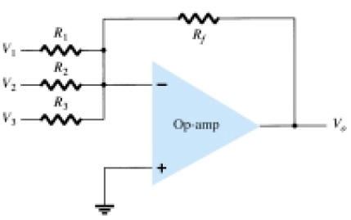

Practical Op-amp circuits
Summing Amplifier
The most used of the
op-amp circuits is the
summing amplifier circuit.
The circuit shows a three-input summing amplifier
circuit, which provides a means of algebraically
summing (adding) three voltages, each multiplied by
a constant-gain factor.

Slide 11
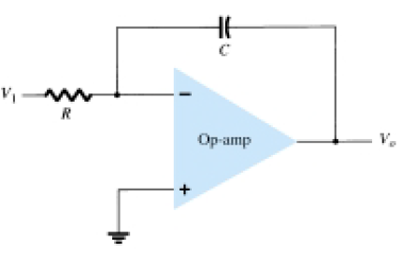


Practical Op-amp circuits
Integrator
If the feedback component
used is a capacitor, the result
is an integrator circuit. The integrator produces a
voltage output proportional to the product
(multiplication) of the input voltage and time.

Slide 12
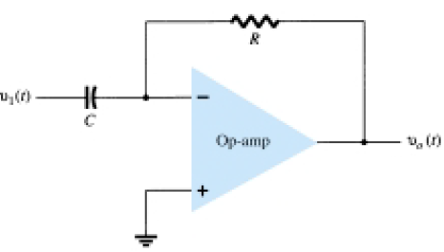
Practical Op-amp circuits
Differentiator
Vo = -RCVi
the differentiator
produces a voltage output proportional to the input voltage’s rate of change.

Slide 13
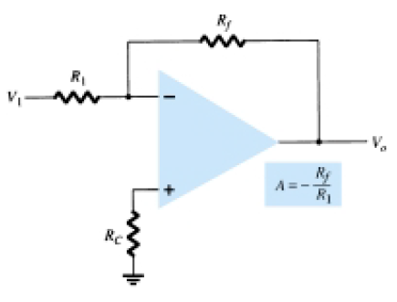


OP AMP APPLICATIONS
CONSTANT GAIN MULTIPLIER
Inverting Fixed Gain Amplifier
One of the most common
op-amp circuits is the inverting
constant-gain multiplier, which
provides a precise gain
or amplification.

Slide 14
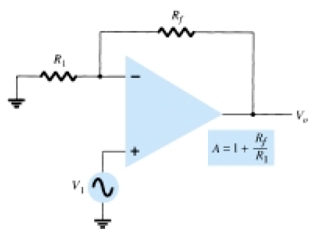

OP AMP APPLICATIONS
Noninverting Fixed Gain Amplifier

Slide 15


OP AMP APPLICATIONS
Multiple-Stage Gains
When a number of stages are connected in series, the overall gain is the product of the individual stage gains. The first stage is connected to provide noninverting gain as given by . The next two stages provide an inverting gain given by
A = A1A2A3
where A1 = 1 + Rf/R1, A2 = -Rf/R2, and A3 = -Rf/R3.

Slide 16
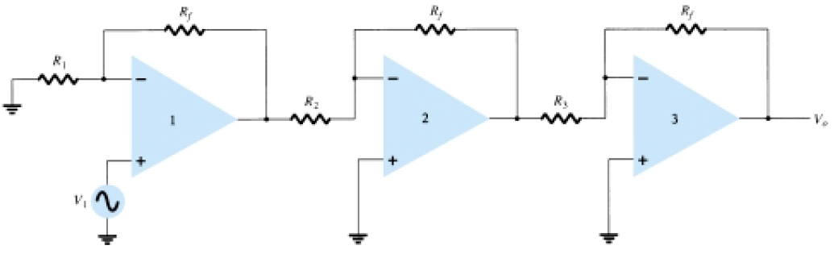
Constant-gain connection with multiple stages

Slide 17
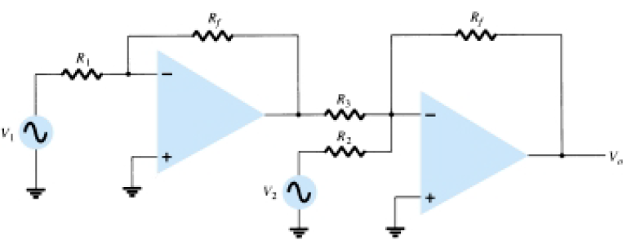
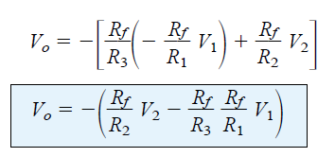
Voltage Subtraction
Two signals can be subtracted, one from the other, in a number of ways. The figure shows two op-amp stages used to provide subtraction of input signals.

Slide 18
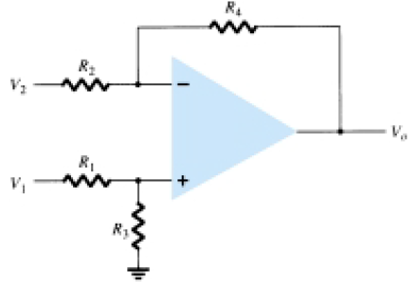

Voltage Subtraction
Another connection to provide subtraction of two signals uses only one op-amp stage to provide subtracting two input signals. Using
superposition the output
can be shown to be:

Slide 19

VOLTAGE BUFFER
A voltage buffer circuit provides a means of isolating an input signal from a load by using a stage having unity voltage gain, with no phase or polarity inversion, and acting as an ideal circuit with very high input impedance and low output impedance.

Slide 20
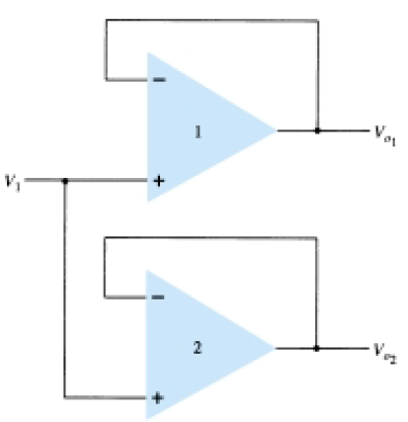
The advantage of this
connection is that the load
connected across one
output has no or little
effect on the other output.
The outputs are buffered
or isolated from each other.

Slide 21

CONTROLLED SOURCES
Voltage-Controlled Voltage Source
Two versions of the circuit are
shown, one using the inverting
input, the other the non-
inverting input. An ideal form
of a voltage source whose
output Vo is controlled by an
input voltage V1.

Slide 22
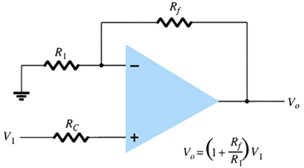

CONTROLLED SOURCES
Voltage-Controlled Voltage Source
The output voltage is
seen to be dependent
on the input voltage
(times a scale factor k).

Slide 23
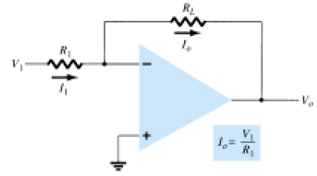

Voltage-Controlled Current Source
An ideal form of circuit providing an output current controlled by an input voltage. The output current is dependent on the input voltage.

Slide 24
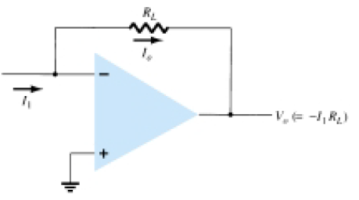

Current-Controlled Voltage Source
The output voltage is dependent on the input current.

Slide 25
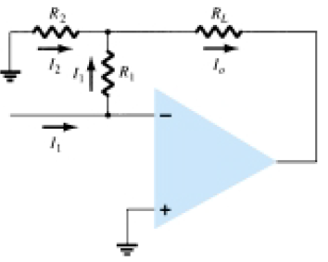

Current-Controlled Current Source
An output current is provided dependent on the input current.

Slide 26

1. An inverting amplifier have a gain = - 8 & a 10 kΩ input impedance. What is the value of the feedback resistor for the circuit?
2. Calculate the output voltage.
R1 = 33 kΩ
Rf = 330 kΩ
V1 = - 0.2 V
V2 = - 0.1 V
R2 = 10 kΩ

Slide 27
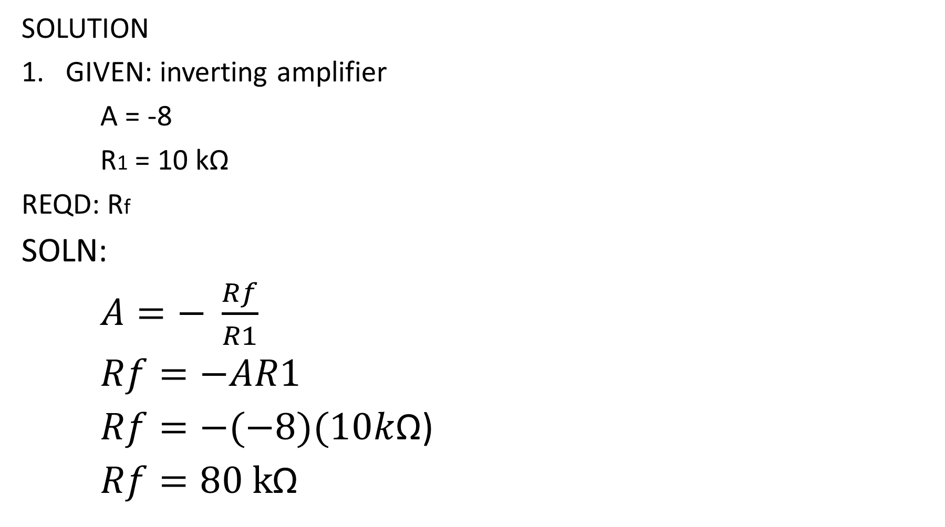
SOLUTION
GIVEN: inverting amplifier
A = -8
R1 = 10 kΩ
REQD: Rf
SOLN:
$A=− \frac{Rf}{R1}$
$Rf=−AR1$
$Rf=−(−8)(10k$Ω)
$Rf=80 k$Ω

Slide 28
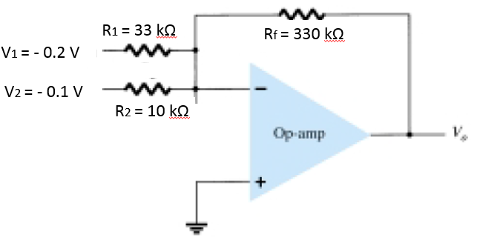
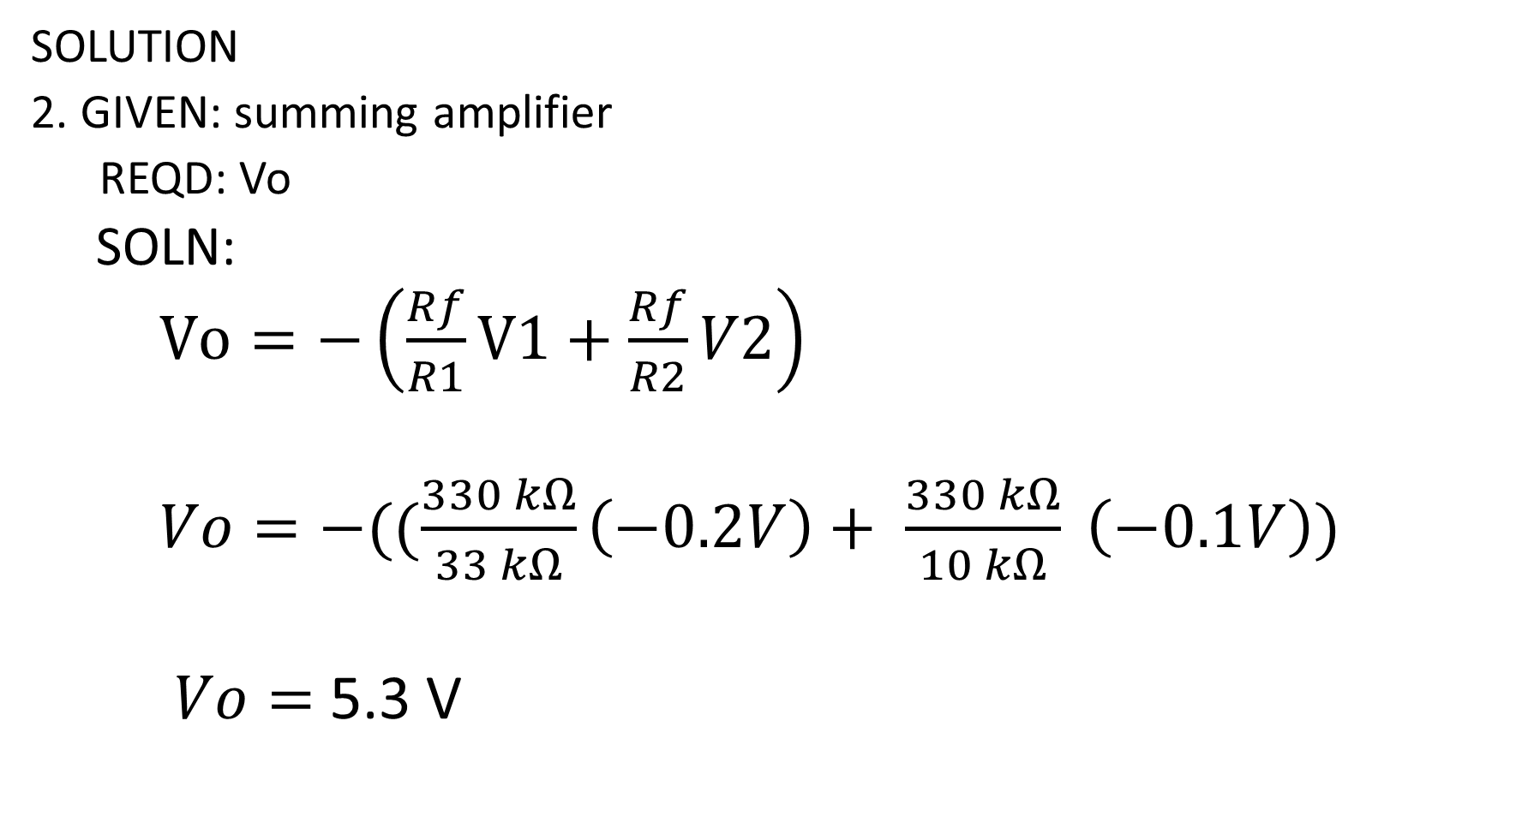
SOLUTION
2. GIVEN: summing amplifier
REQD: Vo
SOLN:
$Vo=−\left(\frac{Rf}{R1}V1+\frac{Rf}{R2}V2\right)$
$Vo=−((\frac{330 kΩ}{33 kΩ}\left(−0.2V\right)+ \frac{330 kΩ}{10 kΩ} \left(−0.1V\right))$
$Vo=$ 5.3 V

Slide 29
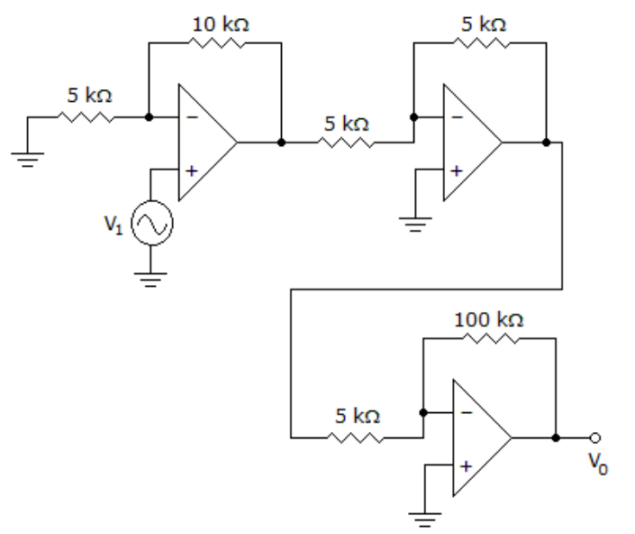
3. Calculate the input voltage.
VO = 10 V

Slide 30
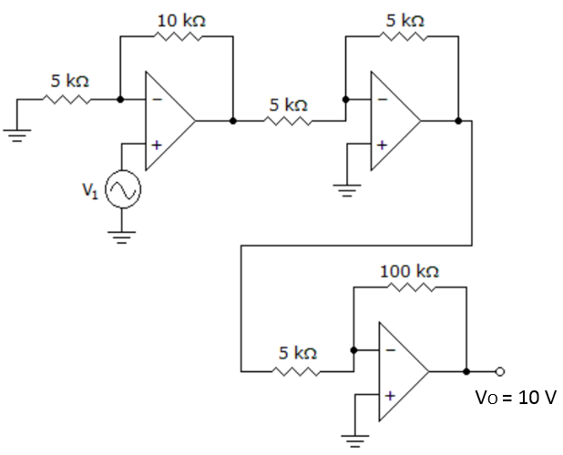
3. REQD: Vi
SOLN:
A = A1A2A3
A = (1 + Rf/R1) Vo = Avi
(-Rf/R2)(-Rf/R3) Vi = Vo/A
A = (1 + 10kΩ/5kΩ) Vi = 10V/60
(-5kΩ/5kΩ)(-100kΩ/5kΩ) Vi = 167 mV
A = 60

Slide 31
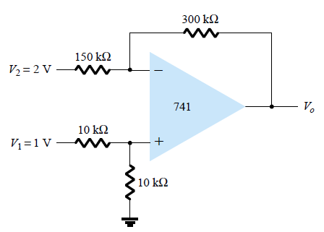
4. Calculate the output voltage.

Slide 32

R4
4. REQD: Vo
SOLN:
$Vo= \frac{10kΩ}{10kΩ+10kΩ}$ $\frac{150kΩ+300kΩ}{150kΩ} 1V − \frac{300kΩ}{150kΩ} 2V$
$$Vo=−2.5 V$$
R2
R1
R3

